Slide 1
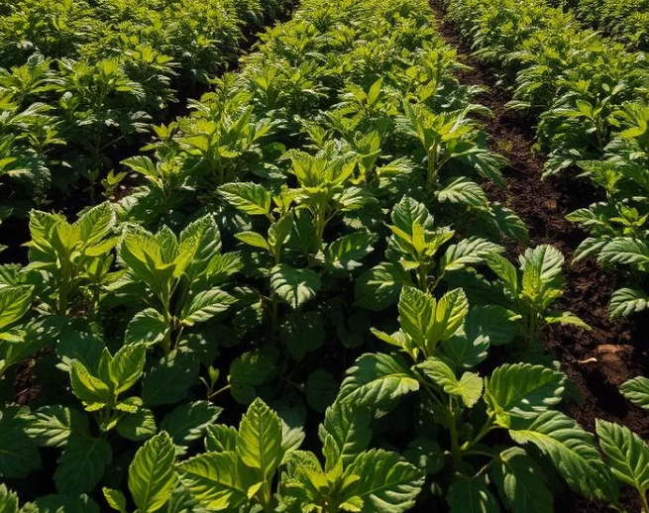
AI/ML IN AGRICULTURE : POTATO LEAF DISEASE CLASSIFICATION
The topic explores the transformative potential of machine learning (ML) in agriculture, focusing on plant disease detection and convolutional neural networks (CNNs) for potato leaf disease classification.
Presenter : Parth Masal

Slide 2
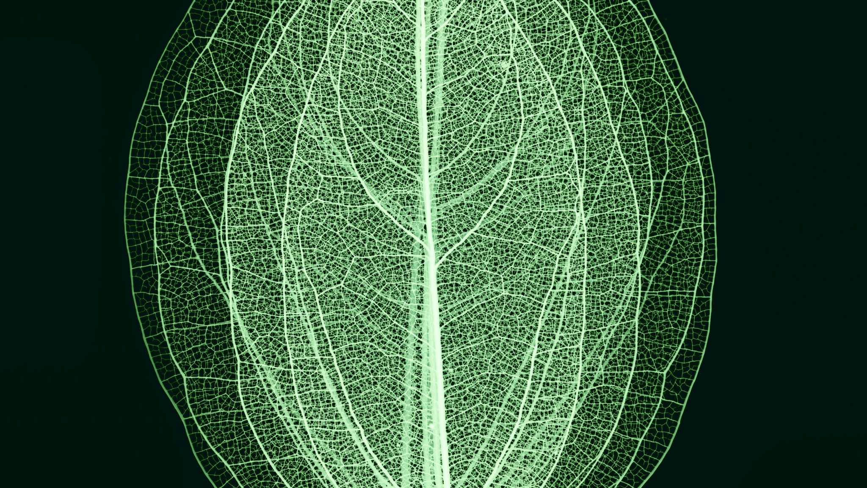
Scope And Objective
Scope
Detect potato leaf diseases (Healthy, Early Blight, Late Blight) using a custom CNN model trained on public datasets, optimized for real-time use on low-power edge devices.
Objectives
Preprocess and augment potato leaf image data
Design a lightweight, high-performing CNN model
Train and validate the model using standard performance metrics
Benchmark against pre-trained models
Optimize the model for edge device deployment

Slide 3

The Evolution of Smart Agriculture
Technological Innovations
Growth Trends
Agriculture has evolved to embrace technological innovations that enhance productivity, sustainability, and efficiency. Smart agriculture leverages AI and ML to optimize crop output and minimize environmental impact.
The application of ML in agriculture has shown substantial growth, driven by the increasing need for food security, sustainability concerns, and the potential for significant productivity gains [1].

Slide 4
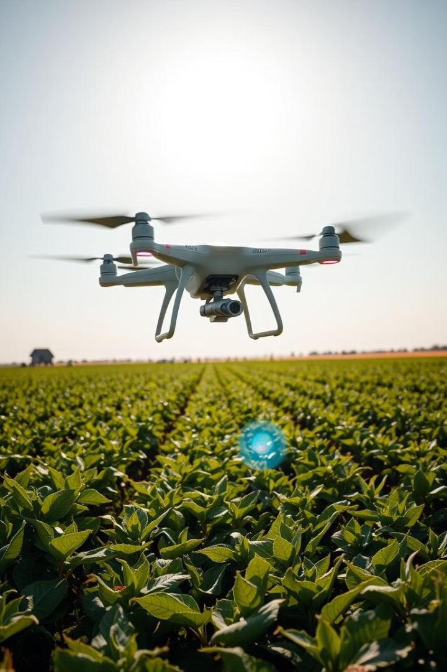



Key Trends in Agricultural ML Applications
Soil Management
Crop Monitoring
ML technologies are deployed for soil management and irrigation optimization.
ML is used for crop monitoring and yield prediction, providing farmers with actionable insights [1].
Real-Time Monitoring
Convergence of IoT sensors, drone technology, and ML algorithms enables real-time monitoring and response systems.

Slide 5
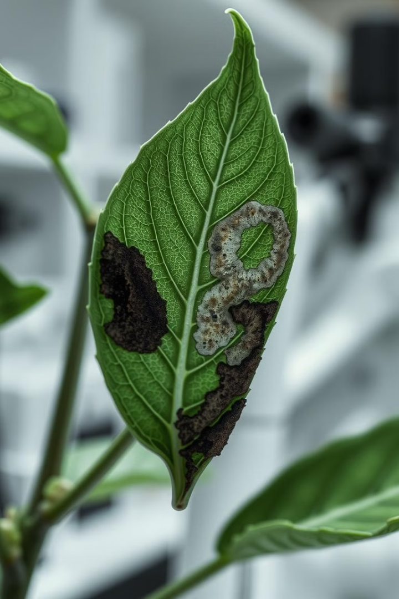
Deep Learning for Plant Disease Detection
Powerful Approach
Deep learning has emerged as a powerful approach for agricultural applications, especially in plant disease detection and classification.
Exceptional Accuracy
CNNs have demonstrated exceptional accuracy in identifying plant diseases from visual data, outperforming traditional image processing techniques [2].

Slide 6





Benefits of Deep Learning in Disease Detection
Automation
Automates the diagnostic process, reducing reliance on expert knowledge.
Complex Patterns
Processes complex patterns and features in plant images.
Scalability
Handles large datasets of diverse plant conditions.
Continuous Learning
Learns continuously from new data, improving accuracy over time.

Slide 7
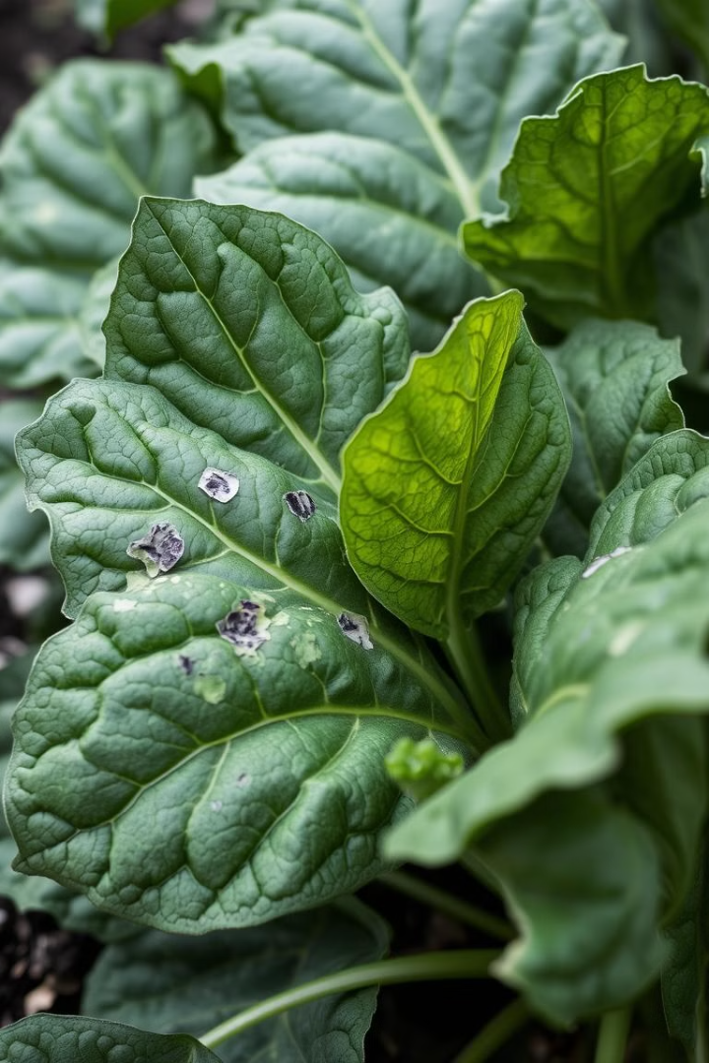



CNN-Based Classification of Potato Leaf Diseases
Vital Crop
Susceptibility
Timely Identification
Potato crops are vital to global food security and economy.
Potatoes are highly susceptible to various leaf diseases that can significantly impact yield and quality [3].
Timely and accurate identification of diseases is critical for implementing effective control measures.

Slide 8
Related Studies
CNN Architectures
VGG16 Performance
Research focuses on applying CNN architectures to classify potato leaf diseases with remarkable success. Models include VGG16, VGG19, DenseNet121, and ResNet50 [2], [3].
A study using VGG16 with transfer learning achieved validation accuracy of 97% and testing accuracy of 98% for potato leaf disease classification [2].

Slide 9
RELATED STUDIES
High Accuracy with CNNs: Studies like Tambe et al. achieved up to 99.1% accuracy in classifying potato leaf diseases using CNNs, showcasing their effectiveness in extracting features from complex patterns.
Value of Quality Datasets: Research using the PlantVillage dataset (e.g., Sofuoglu & Birant) emphasized the importance of large, annotated datasets for training robust models, reporting precision and F-scores above 0.94.
Model Variants and Comparisons: Approaches using MobileNet, ResNet50, and custom CNNs have demonstrated accuracies between 96%–98.34%, validating CNN reliability under controlled conditions.
Data Augmentation & Preprocessing: Techniques like rotation, flipping, and CLAHE have been found to improve model robustness and generalization across different imaging conditions.
Lightweight & Mobile-Friendly Models: Several works (e.g., Bangari & Rachana) explored lightweight CNNs for deployment on edge devices, balancing performance with resource efficiency.
Hybrid & Ensemble Approaches: Combining CNNs with methods like SVMs or using segmentation strategies has enhanced classification accuracy and reduced false positives, especially in complex or subtle cases.

Slide 10

Implementation of CNN Architecture
Dataset Preparation
High-quality training data is essential. Potato leaf disease datasets consist of thousands of images categorized into distinct classes [2], [3].
Model Architecture
Transfer learning with pre-trained CNN architectures is highly effective. Customize VGG16 by removing original classification layers and adding new fully connected layers [2].
Performance Evaluation
A comprehensive evaluation framework is essential for assessing model performance. Key metrics include classification accuracy, precision, recall, and F1-scores [2].

Slide 11
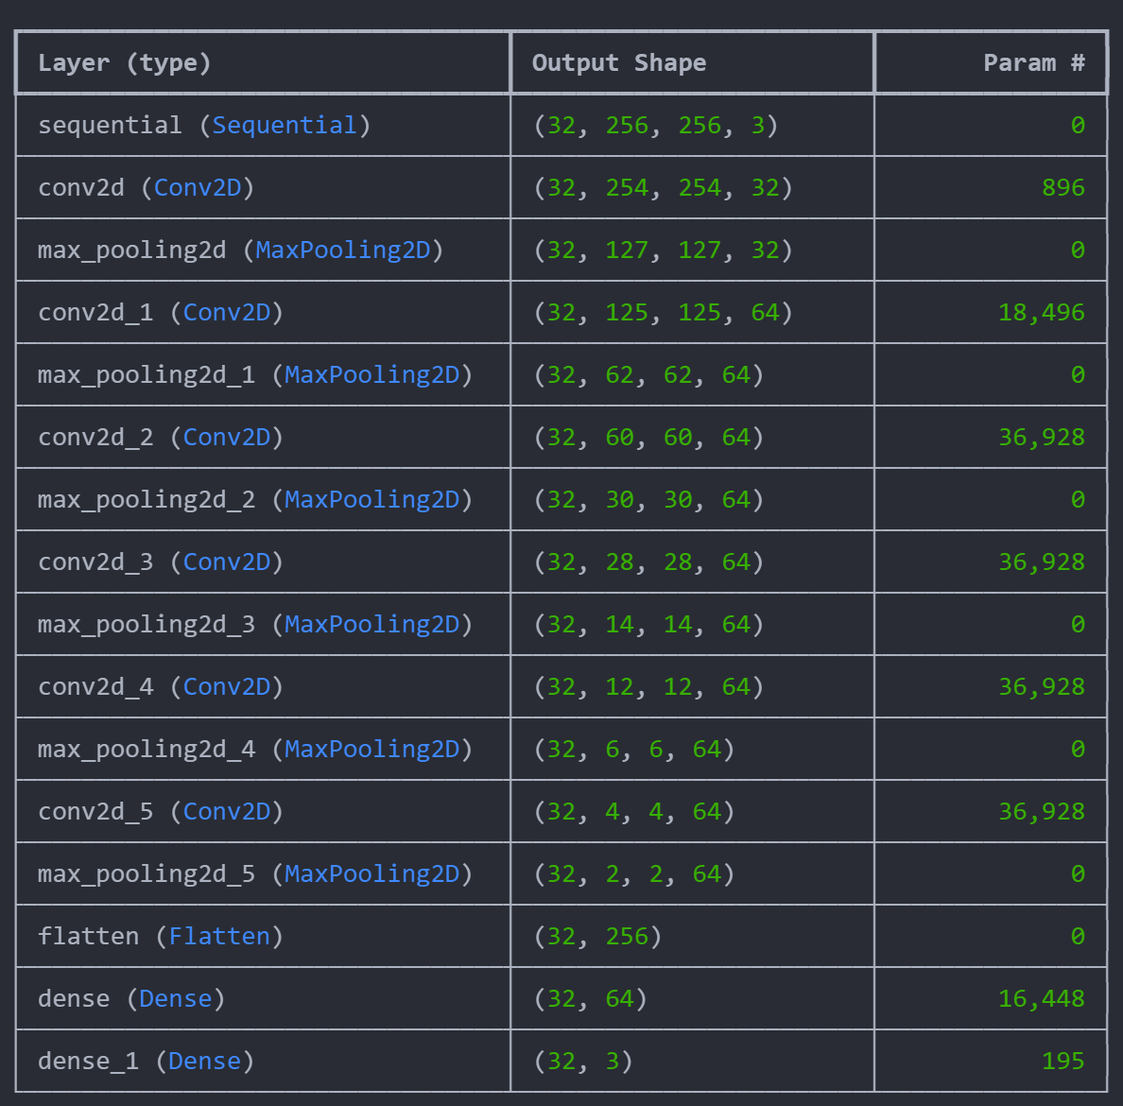
Model Layers

Slide 12
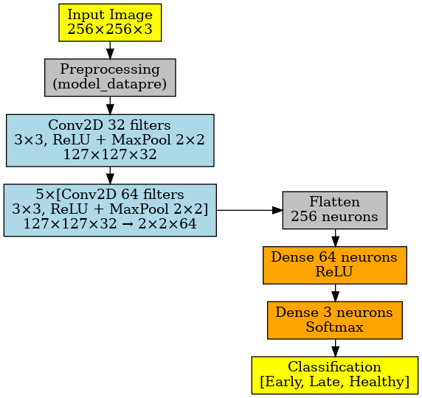
System Design
Image Preprocessing: Input RGB images (256×256×3) undergo resizing, normalization, and data augmentation (rotations, flips, zooms) to improve model generalization and robustness.
Feature Extraction: The image passes through six convolutional-pooling stages, starting with 32 filters and followed by five layers with 64 filters, progressively reducing spatial dimensions while deepening feature representation.
Classification: The final 2×2×64 feature map is flattened and passed through a dense layer (64 neurons, ReLU), and a Softmax output layer classifies images into Early Blight, Late Blight, or Healthy.
Model Efficiency: The model balances performance and efficiency with 183,747 trainable parameters and dimensionality reduction from 256×256 to 2×2.

Slide 13
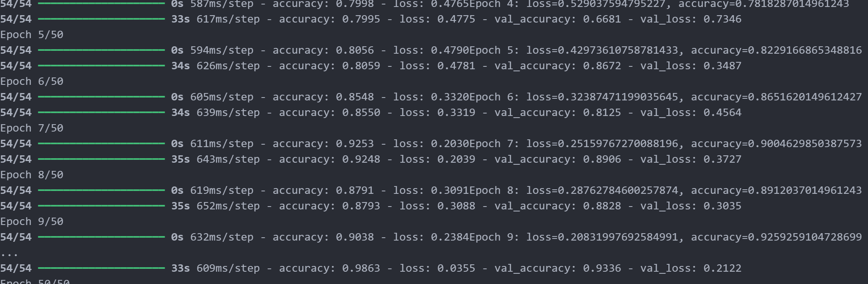
Model Training
Training Setup: The CNN was compiled with the Adam optimizer and Sparse Categorical Cross-Entropy loss for three-class classification, using accuracy as the main metric.
Training Process: Model was trained for 50 epochs with a batch size of 32 and an 80/20 train-validation split. Performance improved consistently, plateauing after 40 epochs, confirming 50 as an optimal choice.
Hardware & Efficiency: Training was done on a CPU-only machine and completed in ~35 minutes, showcasing the model’s ability to train efficiently without GPUs.
Performance Stability: The model’s lightweight design (~183K parameters) allowed smooth convergence, with decreasing loss and increasing accuracy, even on limited hardware.

Slide 14
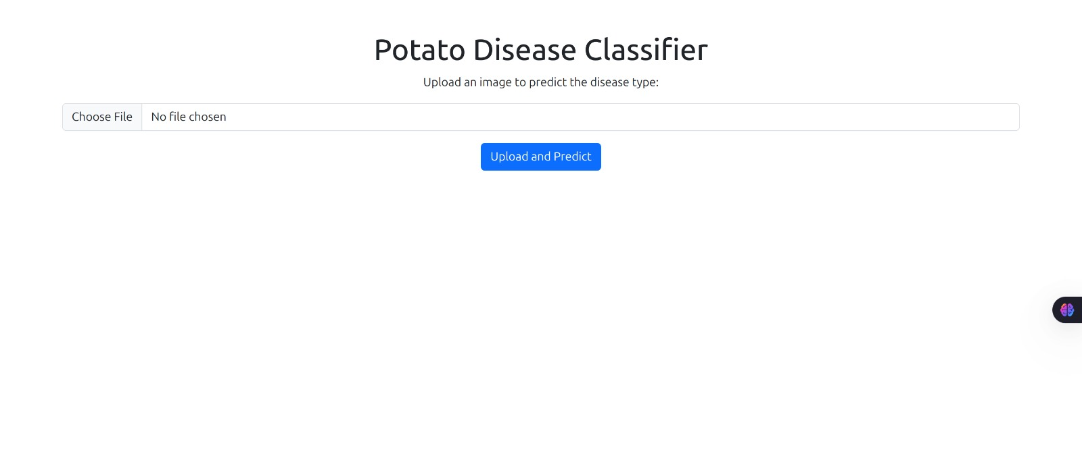
UI

Slide 15
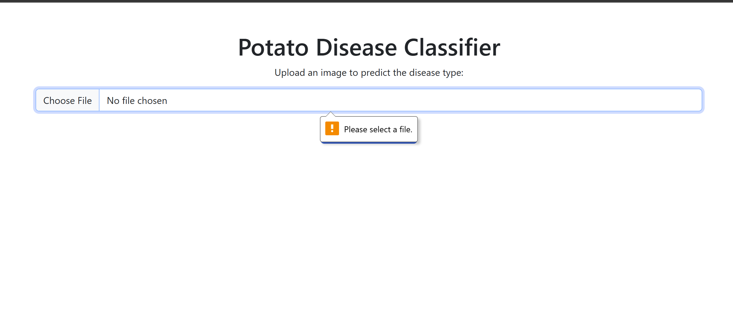
UI

Slide 16
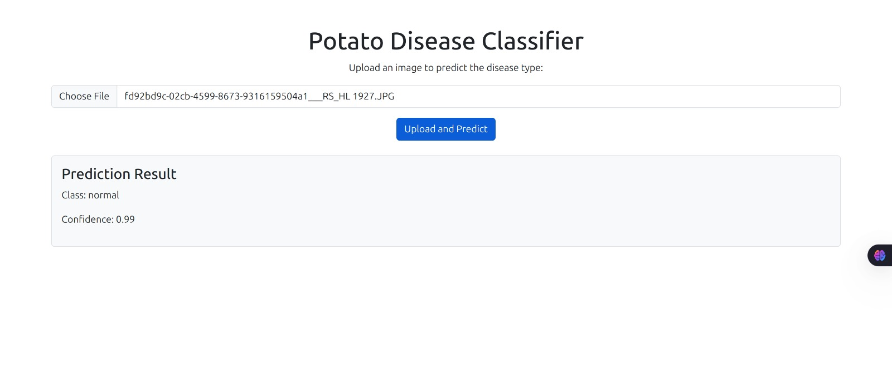
UI

Slide 17
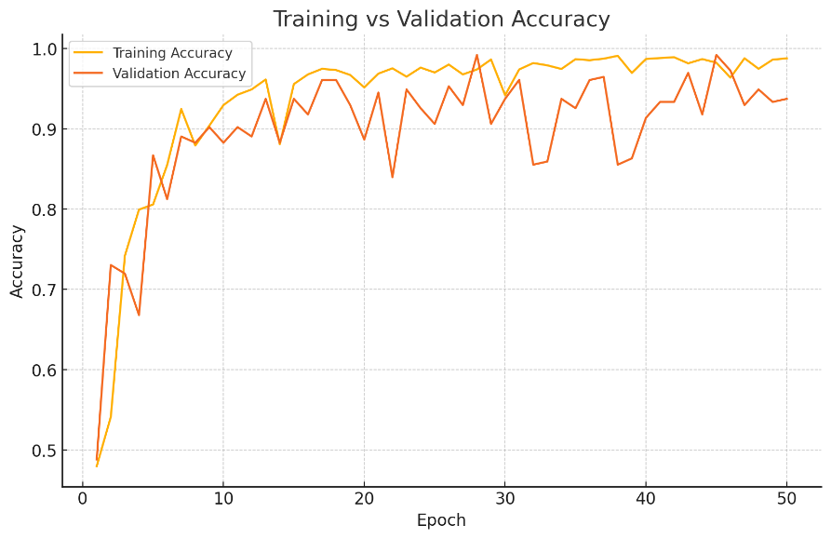
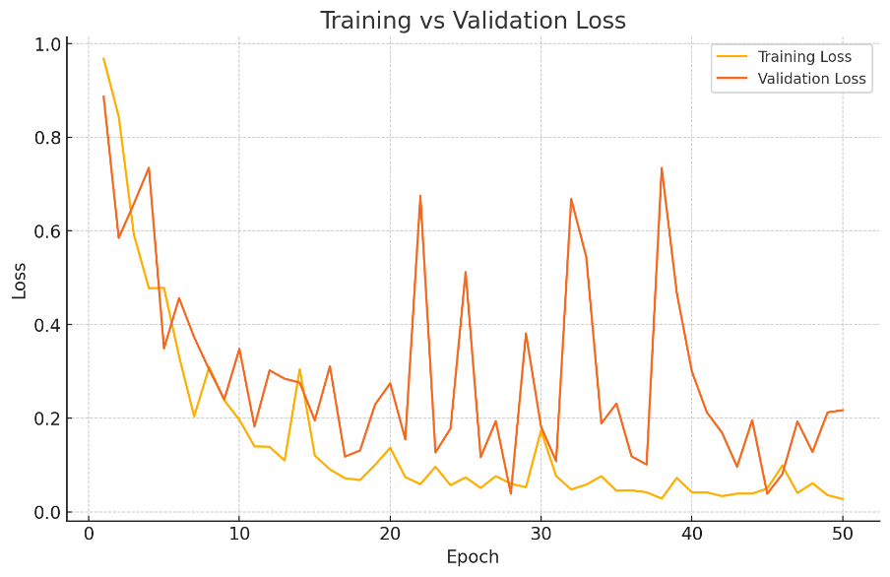
Model Performance

Slide 18



The Role of Explainable AI (XAI)
Model Usability
XAI contributes to model transparency and usability, fostering trust and ensuring seamless integration into agricultural practices [2].
Grad-CAM
Model Transparency
Gradient-weighted class activation mapping (Grad-CAM) enhances model interpretability by visualizing influential regions in the CNN's classification decisions [2].
Integration of Explainable AI (XAI) techniques provides interpretable insights into the decision-making process of deep learning models [2].
2
1
3

Slide 19
Expanded Disease Coverage:
Larger & Diverse Datasets
Integration with Aerial Imagery
Mobile & IoT Deployment
Smart Farming Ecosystem
Future Scope

Slide 20
A custom CNN model was developed to accurately detect and classify potato leaf diseases—early blight, late blight, and healthy leaves—using a labeled dataset and effective image preprocessing techniques. Data augmentation enhanced generalization, resulting in strong classification performance. This system provides a practical solution for early disease detection, helping reduce crop loss and improve yield. It holds potential for deployment on mobile or web platforms to assist farmers in real time. Future advancements could include broader crop coverage, dataset expansion, and edge-optimized deployment for smart farming applications.
Conclusion

Slide 21
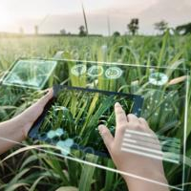
Thank You

